Slide 1
Syllabus of Embedded System
Unit 1: Introduction to Embedded systems (3 Hours)
1.1 Definition and overview of Embedded Systems
1.2 Embedded Systems vs General Purpose Systems
1.3 Applications and Domain ( Automotive, Healthcare, Industrial Control, IoT etc)
1.4 Key Components: Microcontrollers, sensors, Actuators, Peripherals

Slide 2
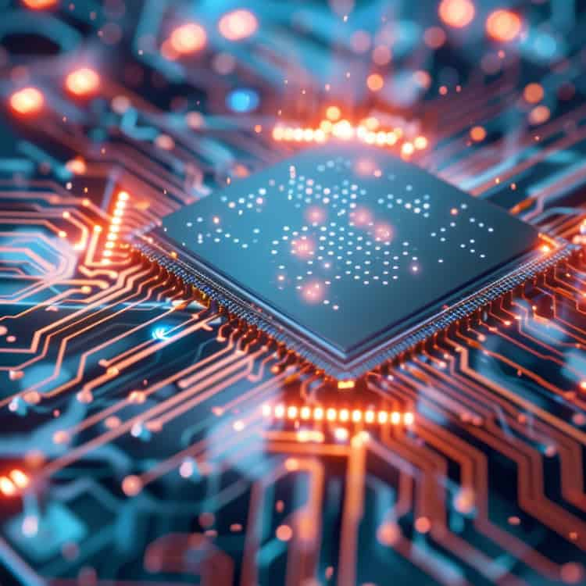
Definition and overview of Embedded system
An embedded system is nearly any computing system other than a desktop, laptop, or mainframe computer.
-Embedded System Design
An embedded system is a specialized computer system with a dedicated function within a larger mechanical or electronic device.

Slide 3
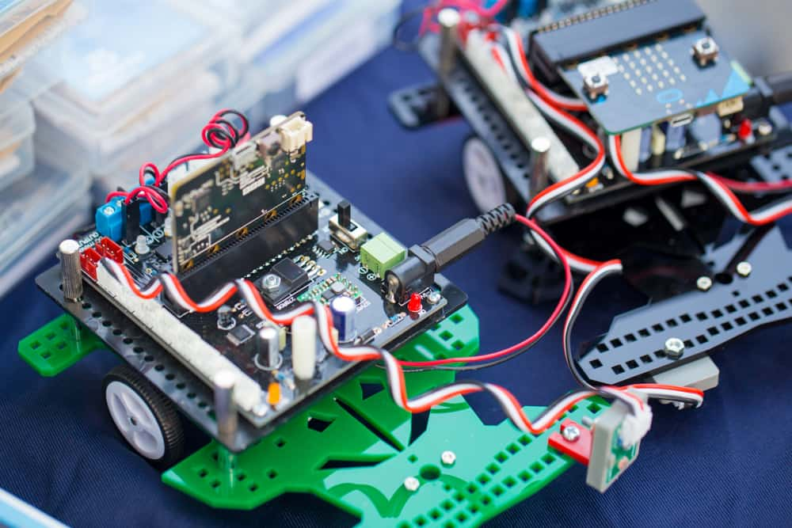
Definition and overview of Embedded system
An embedded system is a microcontroller or microprocessor-based hardware and software system designed to perform a specific task or function.

Slide 4
Common Characteristics of an embedded system
Definition and overview of Embedded system
Single Functioned
S
Executes only one program, repeatedly
C
Tightly Constrained
Tight constraints on design metrics
Reactive and real time
R
Continually react to changes in environment
P
Processor based
Microprocessors or microcontrollers are used

Slide 5
Embedded systems vs General purpose system
Embedded System
General Purpose
Purpose
Dedicated
General
User Interface
Minimal
Complex and Standard
Resources
Contrained
Abundant
Performance
Deterministic and real-time
High-throughput

Slide 6
Embedded systems vs General purpose system
Embedded System
General Purpose
Operating system
Real-Time OS
General Purpose OS
Boot time
Very fast
Slower
Upgradability
Infrequent
Frequent
Examples
ABS in car
Desktop PC

Slide 7
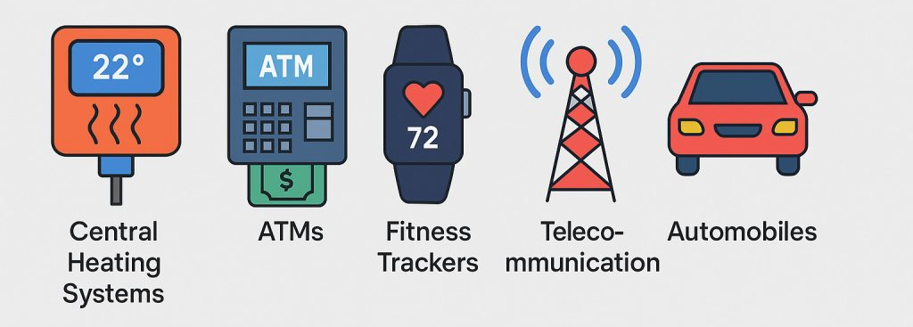
Application and Domain
Over 98% of all microprocessors manufactured are used in embedded system

Slide 8
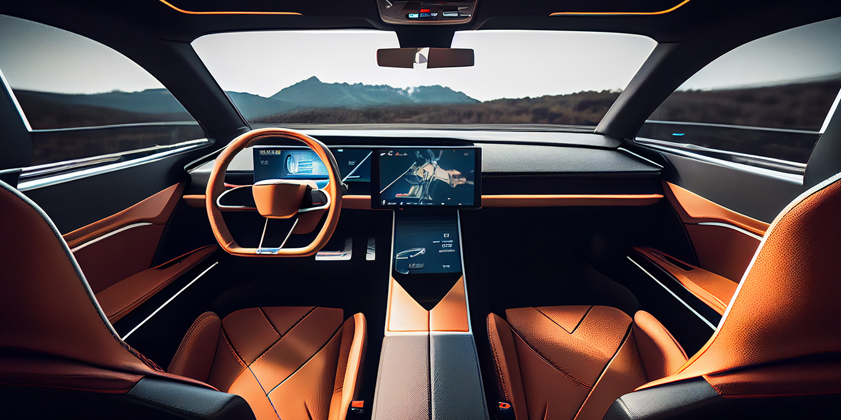
Application and Domain
Automotive
Engine Control Unit (ECU): manages engine performance
Anti-lock Braking System (ABS): Prevents wheel lock -up
Airbag Control Unit: Deploys airbags in a collision
Advanced Driver-Assistance System (ADAS) : Autonomous Driving

Slide 9
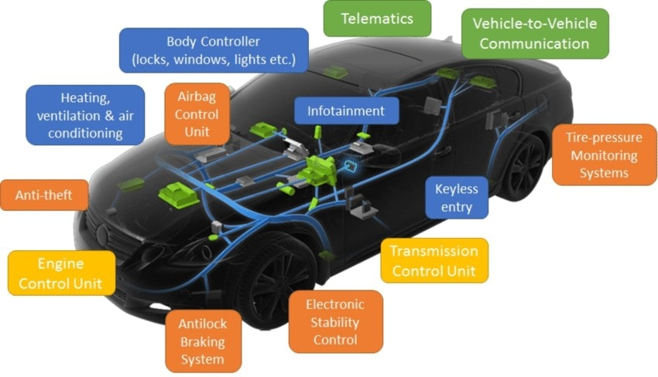
Application and Domain
Automotive

Slide 10
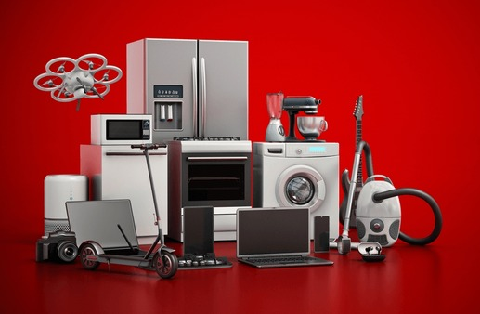
Application and Domain
Consumer Electronics
Smartphones and Tablets: Collections of embedded systems
Smart TVs: Run a specialized OS for media playback
Digital Cameras: Image processing
Wearables: Smartwatches, fitness trackers

Slide 11
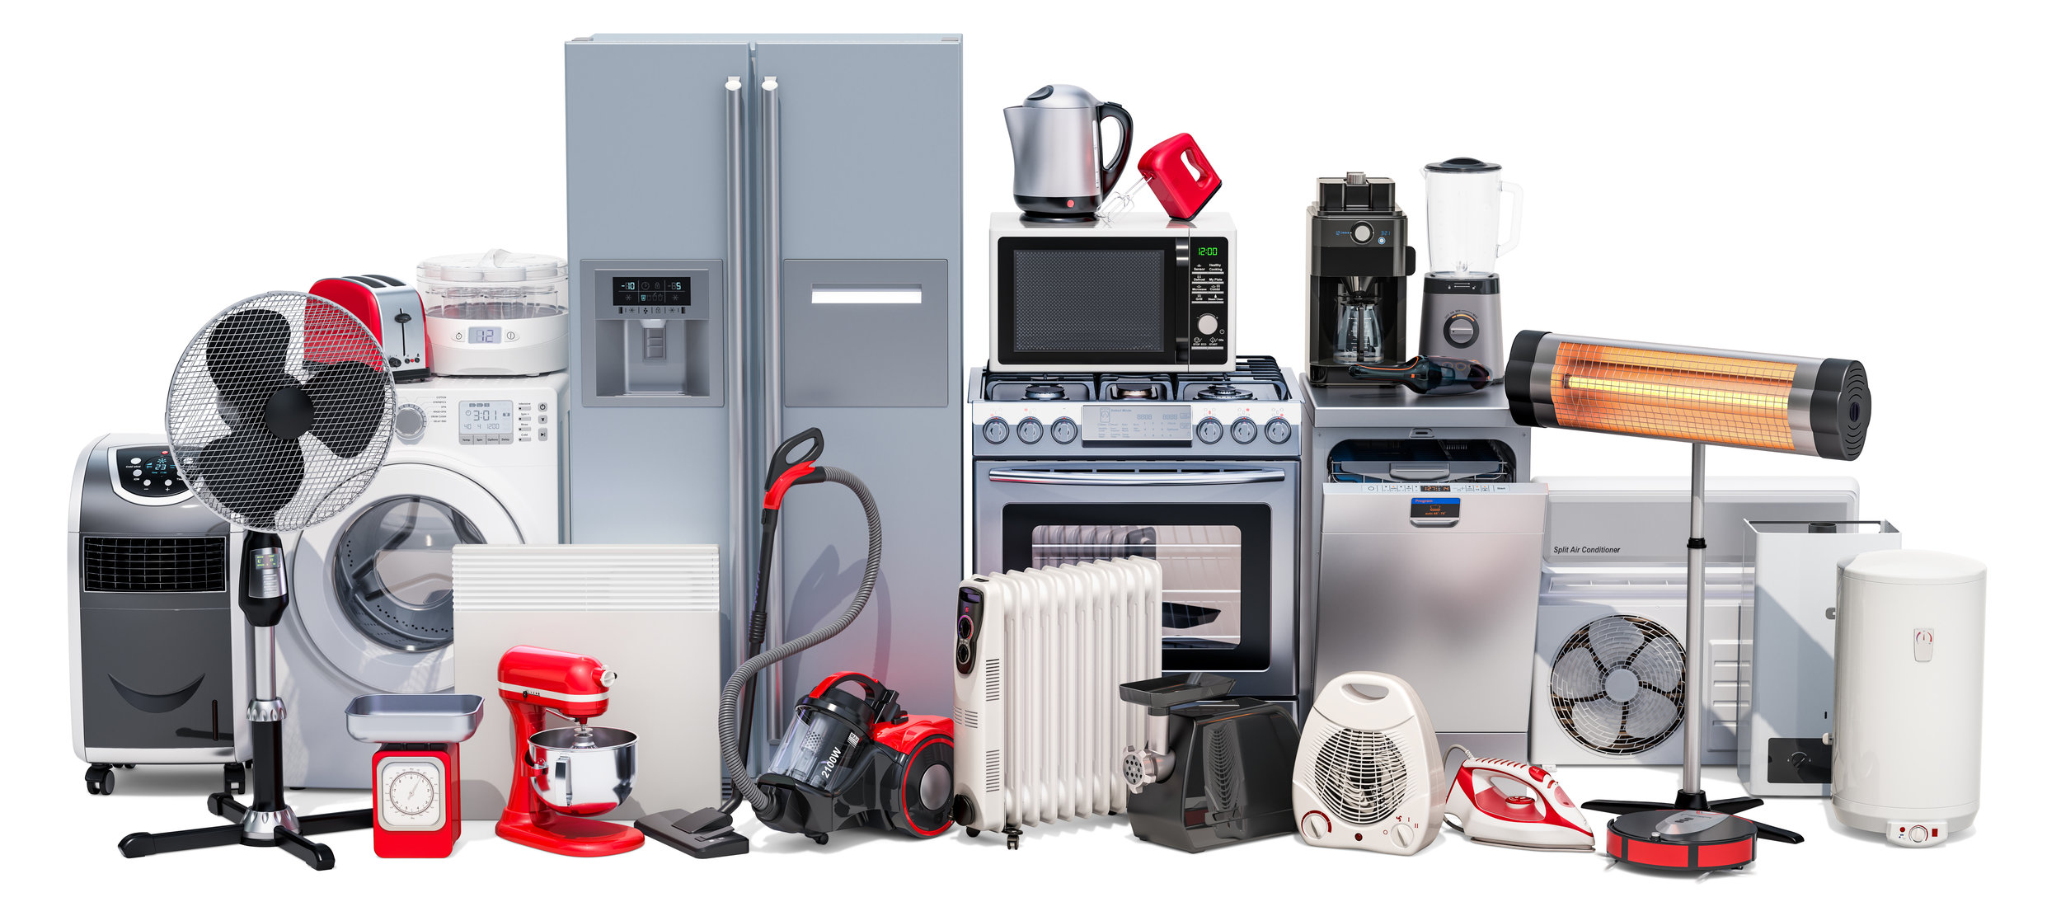
Application and Domain
Consumer Electronics

Slide 12
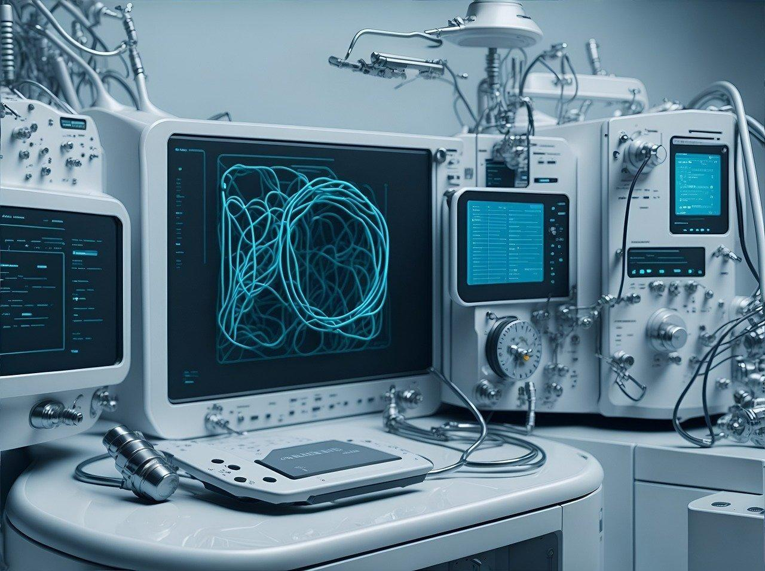
Application and Domain
Healthcare and Medical
Patient Monitoring Systems: Heart rate, blood pressure
Medical Imaging: MRI, CT Scan and ultrasound machines
Implantable Devices: Pacemakers, Insulin Pumps
Portable Diagnostic Devices: Glucose meters, ECG machines

Slide 13
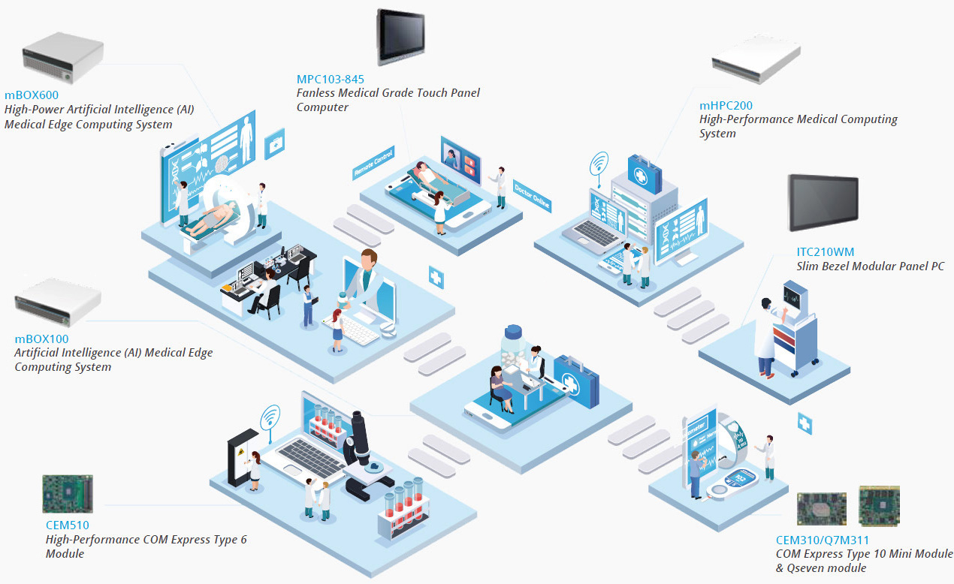
Application and Domain
Healthcare and Medical

Slide 14
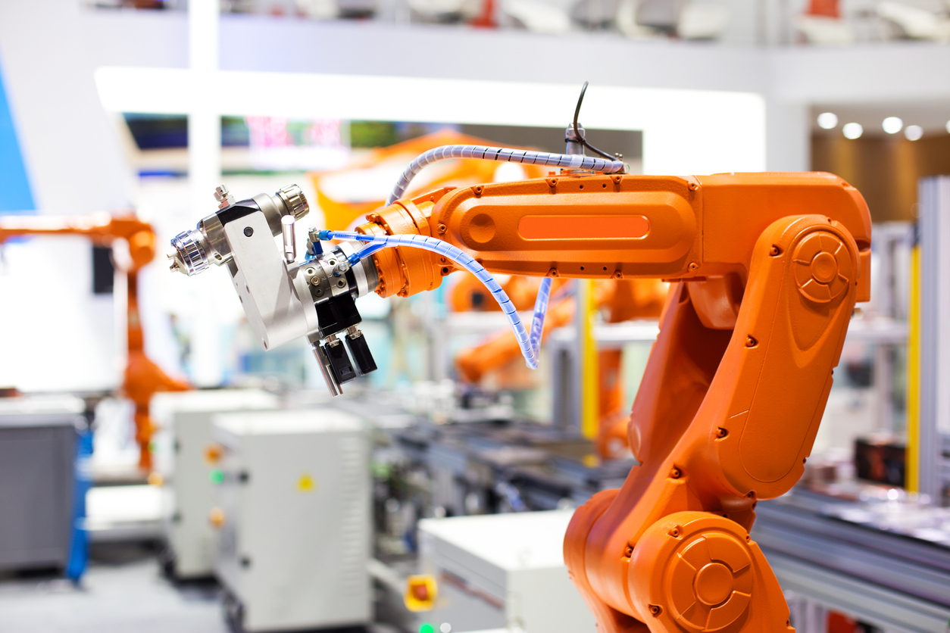
Application and Domain
Industrial Automation
Robotics: Arm control, sensing
CNC machine: For precise cutting, milling and drilling
Programmable Logic Controllers

Slide 15
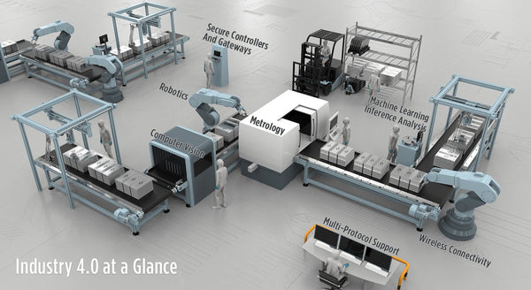
Application and Domain
Industrial Automation

Slide 16
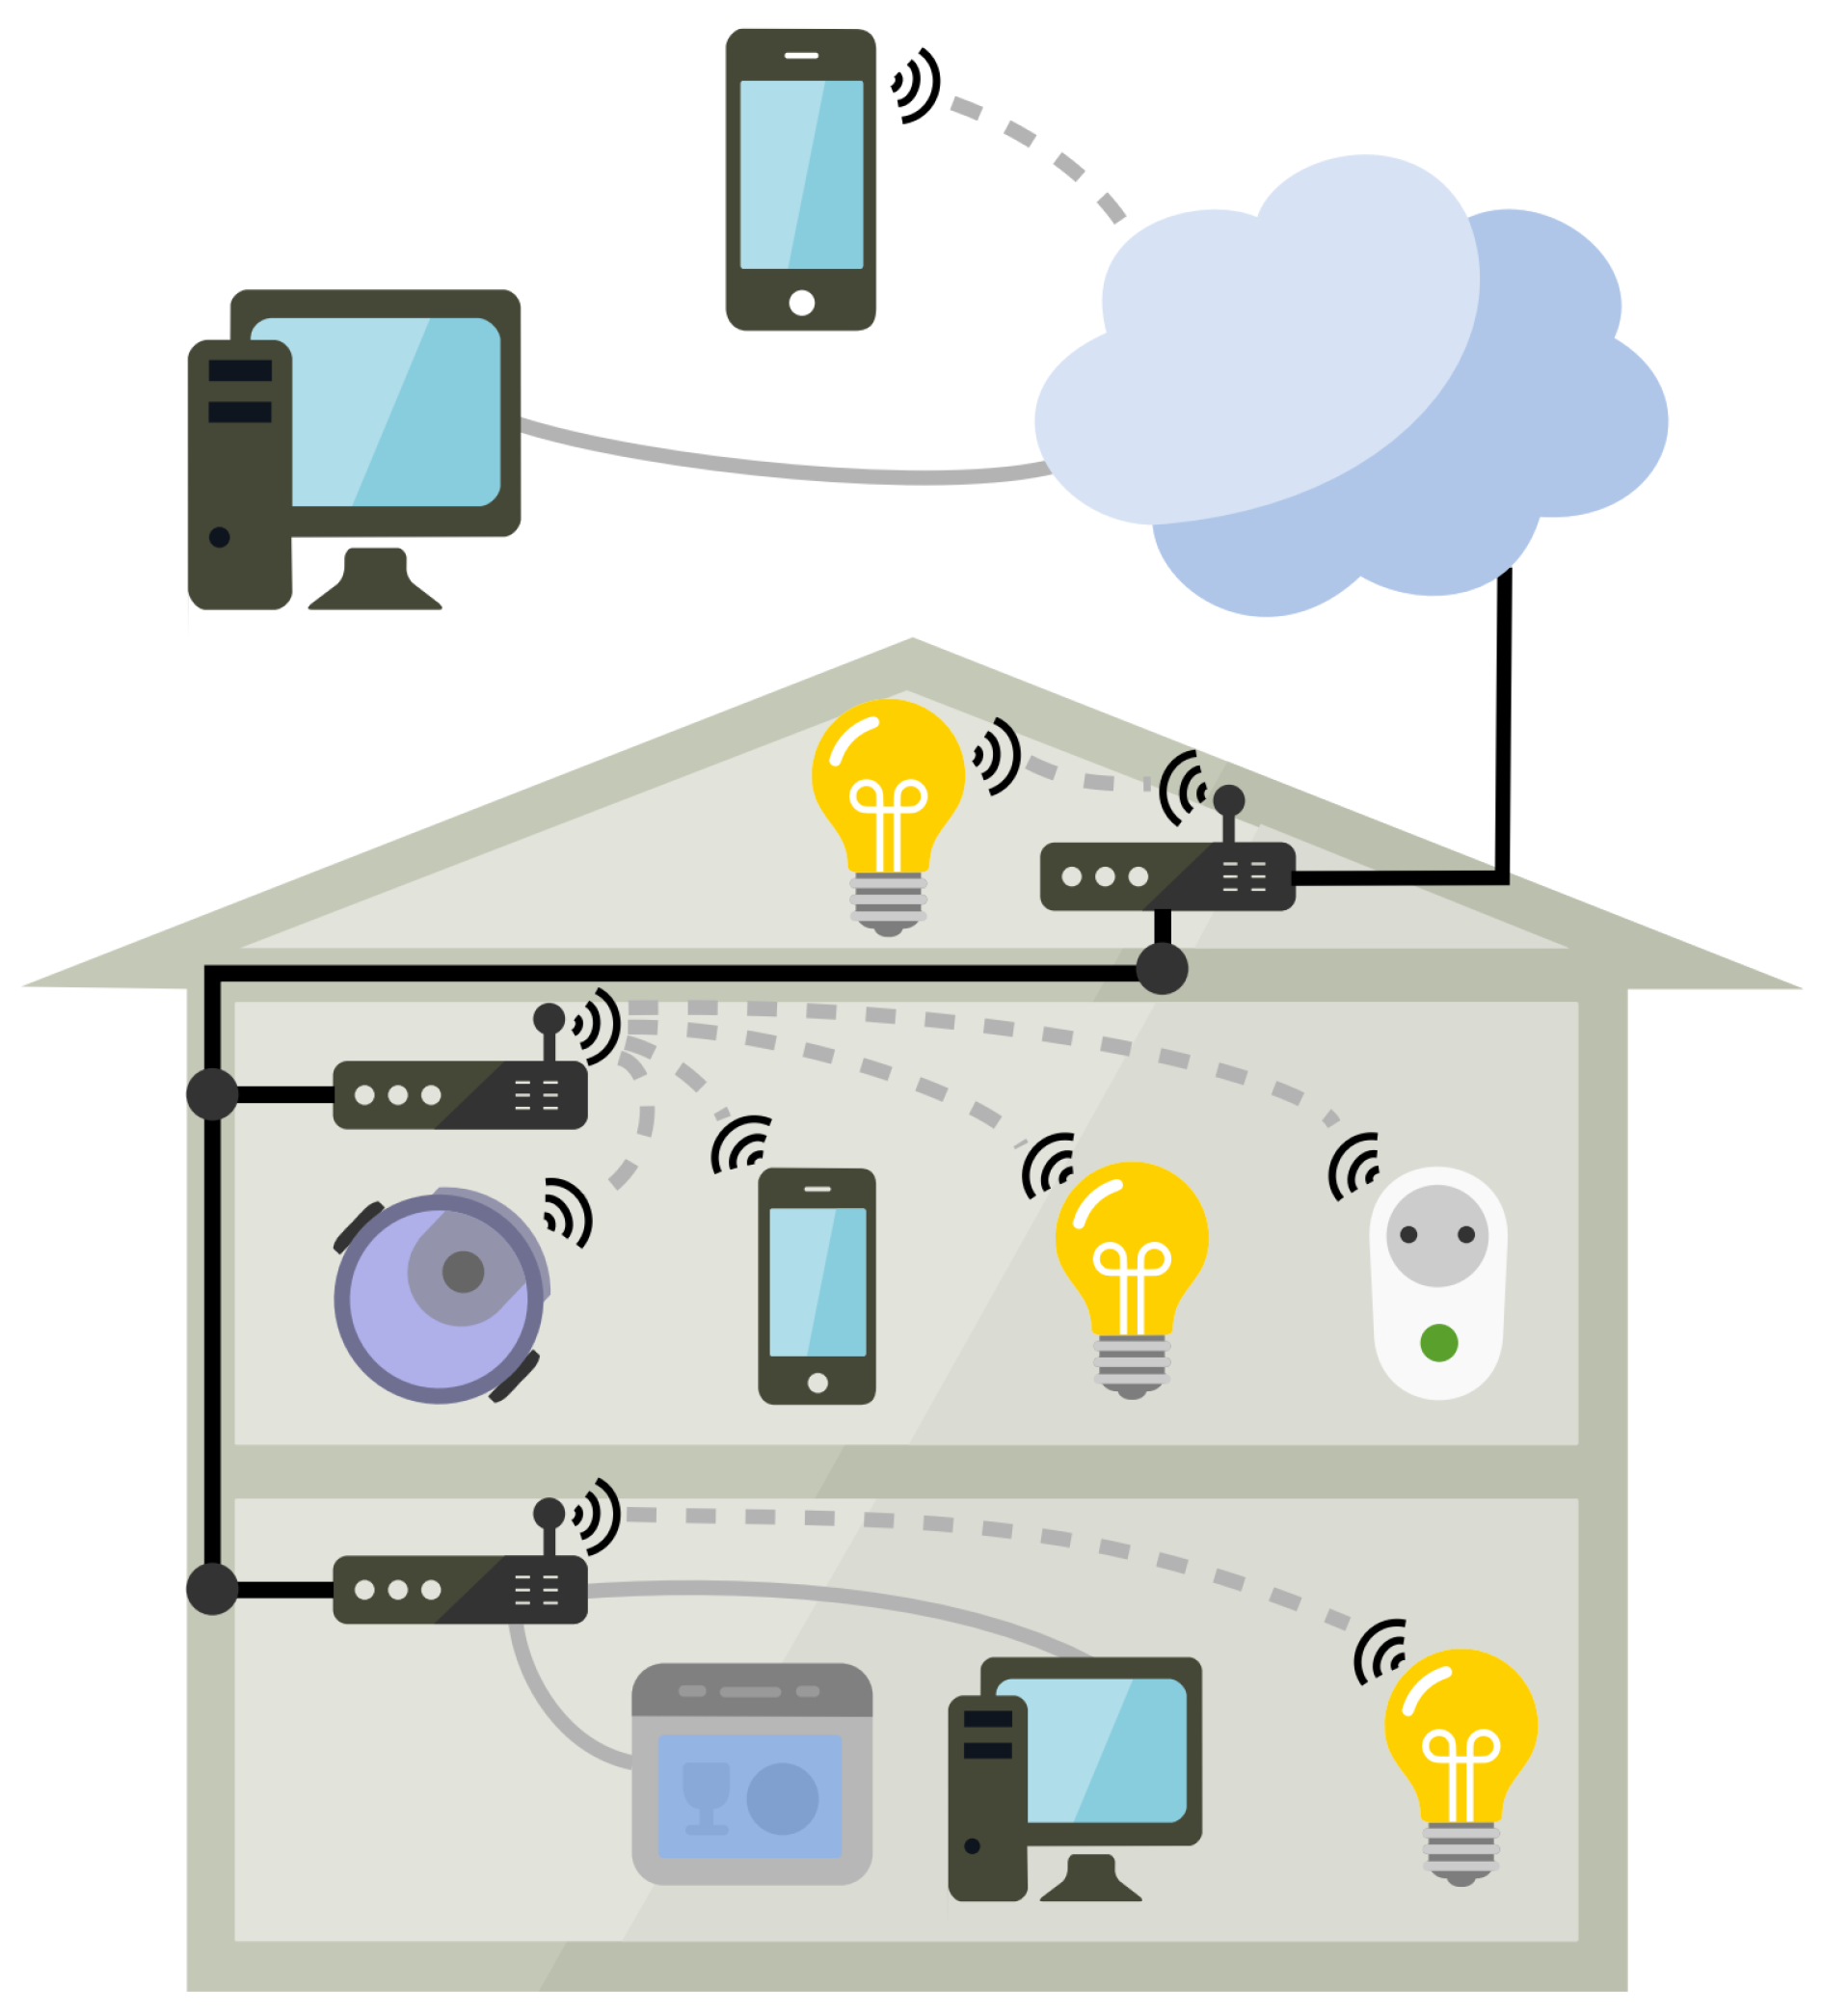
Application and Domain
IoT and Smart Homes
Smart Thermostats: Learn and manage home temperature.
Security Systems: Smart locks, Cameras and motion sensors
Home Assistants: Amazon echo, Google Home
Smart Appliances: Remotely controlled and automated

Slide 17
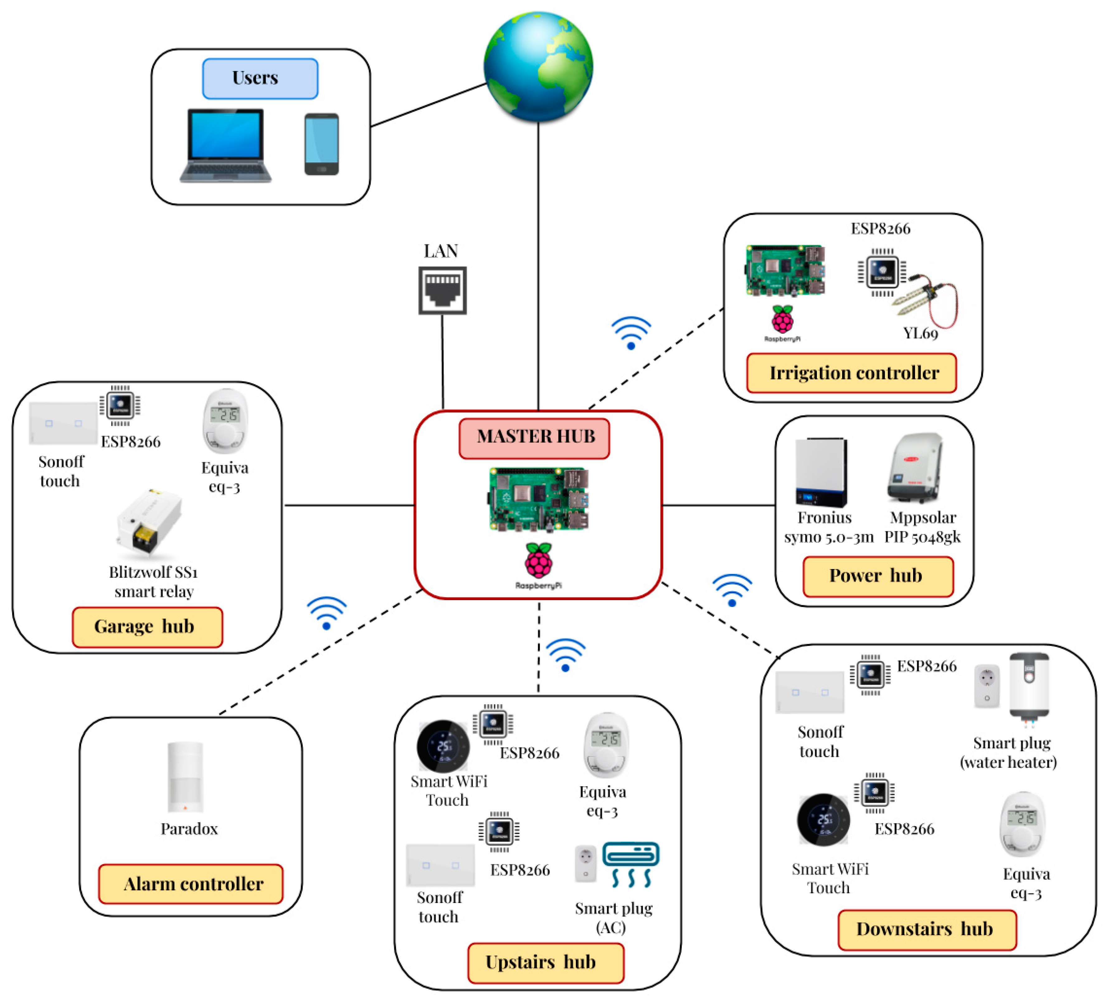
Application and Domain
Healthcare and Medical

Slide 18

Application and Domain
Aerospace and Defense
Avionics: flight control system, navigation
Fly-by-wire systems: Electronic aircraft control
Satellite Systems: Communication, data processing
Military Systems: Drones, missile guidance

Slide 19
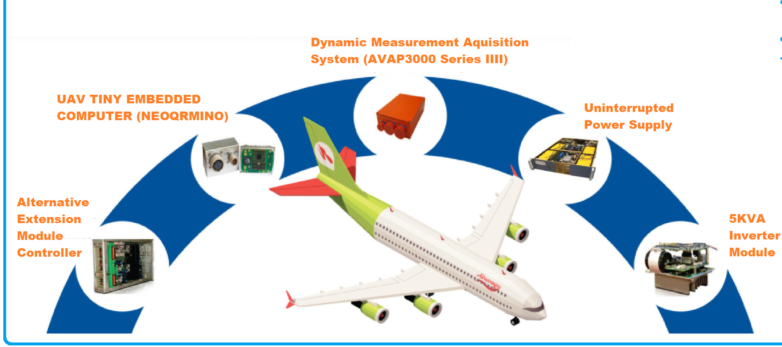
Application and Domain
Aerospace and Defense

Slide 20
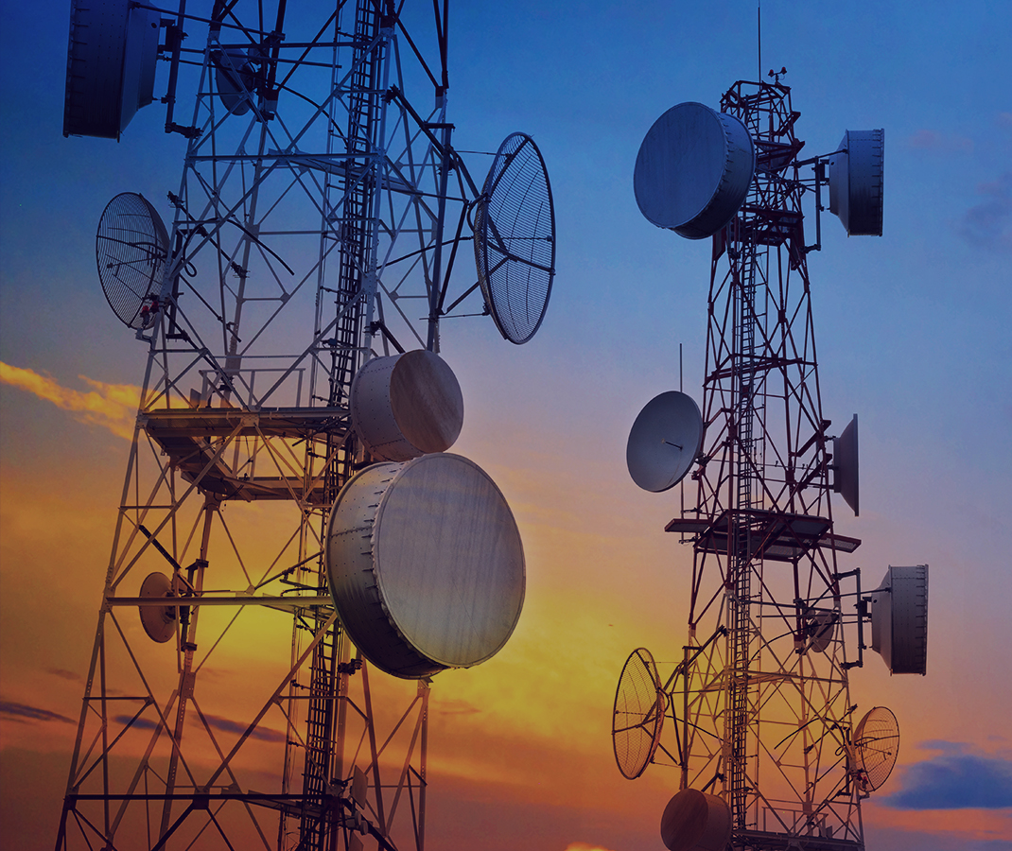
Application and Domain
Telecommunications
Network Routers and Switches
Cellular Base Stations
Modems and Setup Boxes

Slide 21
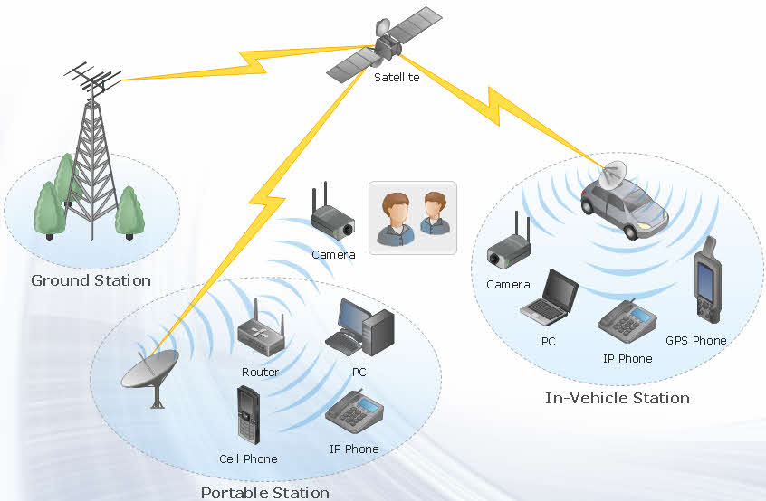
Application and Domain
Telecommunications

Slide 22
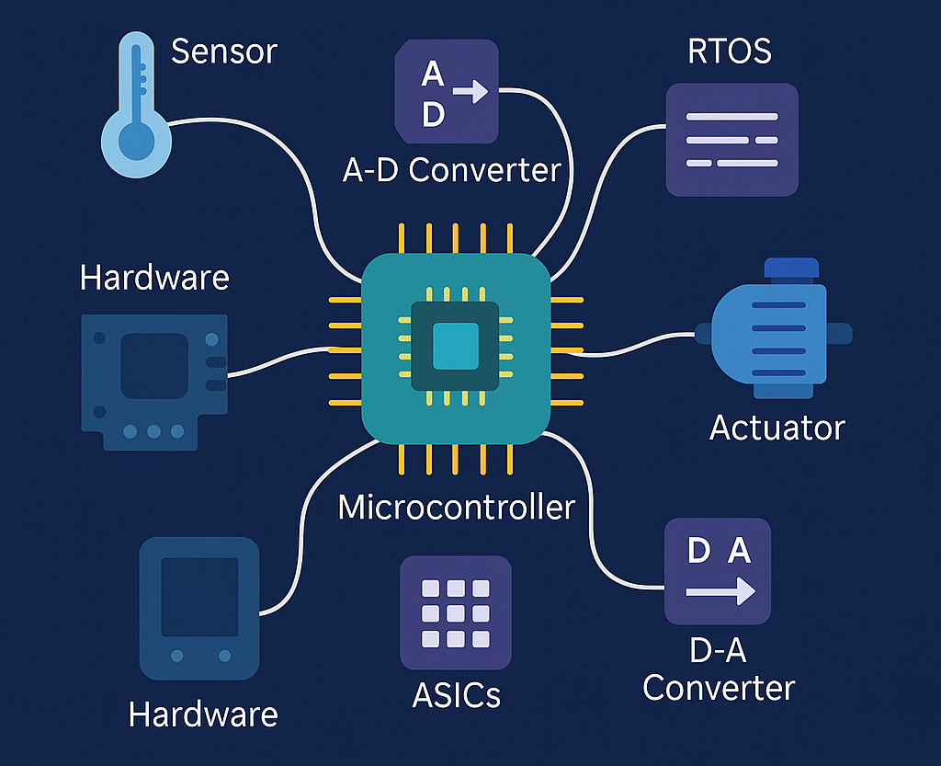
Key Components
An embedded system is made up of several critical components that work in unison to execute its dedicated operations. Each component plays a distinct role in ensuring the system’s reliability, responsiveness, and efficiency.

Slide 23
Key Components
Hardware: Hardware is the tangible infrastructure that hosts all other components and connections.

Slide 24
Key Components
Microprocessor/Microcontroller: These are the brain of the embedded system that controls and process information.

Slide 25
Key Components
Software: Software embedded into ROM or Flash memory controls hardware operations.

Slide 26
Key Components
RTOS: For systems requiring task prioritization and multitasking, an RTOS manages processes based on time constraints and deadlines.

Slide 27
Key Components
Sensors: These devices detect physical parameters and convert them into electrical signals.

Slide 28
Key Components
ADC: Translates analog signals from sensors into digital values for processing by the microcontroller.

Slide 29
Key Components
DAC: Converts processed digital data back to analog format to control devices like speakers.

Slide 30
Key Components
Actuators: Act based on processed signals to perform a mechanical action.

Slide 31
Key Components
Communication interfaces: Allow embedded systems to communicate internally or with external systems.

Slide 32
Key Components
Memory units: Consist of RAM and ROM/Flash. The type and size depend on system complexity.

Slide 33
Key Components
Power Supply Unit: Converts the incoming power to levels suitable for the embedded device.

Slide 34
Key Components
Timers and Counters: Facilitate event tracking, timing operations, signal generation, and system clocking for synchronization purposes.

